Slide 1
Lambda Calculus
Programming Languages
Lecture 8
Adeesha Wijayasiri

Slide 2
Lambda Calculus
To obtain the "value" of an RPAL program:
1. Transduce RPAL source to an AST.
2. Standardize the AST into ST.
3. Linearize the ST into a lambda-expression.
4. Evaluate the lambda-expression, using the CSE machine
Notes:
`

Slide 3
First, need some theory.
RPAL’s flattener grammar: use bracket tree notation: <‘root’ s₁ … s_{n}>
RPAL → E
E → <'γ' E E > => E E
→ <'λ' V E > => 'λ' V '.' E
→ <id:x> => x
→ <integer:i> => i
→ <string:s> => s
→ 'true' => 'true'
→ 'false' => 'false'
. . .
end RPAL.

Slide 4
Result of Tree Flattening: a string
An Applicative Expression (AE).
The interpretation of the AE is ambiguous.
Need parentheses to disambiguate.

Slide 5
Disambiguation Rules
Function application is left associative.
If an expression of the form λx.M occurs in a larger expression, then M is extended as far as possible (i.e. to the end of the entire expression or to the next unmatched right parenthesis).

Slide 6
Example:
λ x. λ y.+xy 2 3
is equivalent to
λ x.(λ y.+xy 2 3)
Must be parenthesized to obtain the intended expression:
(λ x. λ y.+xy) 2 3.

Slide 7
Definition
Let M and N be λ-expressions. An occurrence of x in a λ-expression is free if it can be proved so via the following three rules:
The occurrence of x in λ-expression "x" is free.
Any free occurrence of x in either M or N is free in M N.
Any free occurrence of x in M is free in λy.M, if x and y are different.

Slide 8
Practical, Equivalent Definition
An occurrence of x in M is free if the path from x to the root of M includes no λ node with x on its left.
Definition:
An occurrence of x in a λ-expression M is said to be bound if it is not free in M.

Slide 9
Examples:
a - a occurs free
x - x occurs free
a x - a and x both occur free
(λ x.ax)x - a occurs free; x occurs both free and bound
(λ x. λ y.x+y) y 3
- first occurrence of y is not free,
second occurrence is free,
in the entire expression.

Slide 10
More definitions
Definition:
In an expression of the form λ x.M, x is the bound variable, and M is the body.
Definition:
The scope of an identifier x, in an expression of the form λ x.M, consists of all free occurrences of x in M.

Slide 11
Axiom Delta
Let M and N be AE's that do not contain
λ-expressions.
Then M =>_{δ} N if Val(M) = Val(N).
We say that M and N are delta-convertible, pronounced “M delta reduces to N”.
Val: Value obtained from ordinary evaluation.
Example: +35 =>_{δ} 8.

Slide 12
Axiom Alpha
Let x and y be names, and M be an AE with no free occurrences of y. Then, in any context, λ x.M =>_{α} λ y.subst[y,x,M]
subst[y,x,M] means "substitute y for x in M".
Axiom Alpha used to rename the bound variable.
Example: λx.+x3 =>_{α} λ y.+y3

Slide 13
Axiom Beta
Let x be a name, and M and N be AE's. Then, in any context, (λx.M) N =>_{β} subst[N,x,M].
Called a "beta-reduction", used to apply a function to its argument.
Pronounced “beta reduces to”.

Slide 14
Definition (subst):
Let M and N be AE's, and x be a name.
Then subst[N,x,M], also denoted as [N/x]M, means:
If M is an identifier, then
1.1. if M=x, then return N.
1.2. if M is not x, then return M.
If M is of the form X Y, then return ([N/x]X) ([N/x]Y).

Slide 15
Definition (subst[N,x,M], cont’d)
If M is of the form λ y.Y, then
3.1. if y=x then return λ y.Y.
3.2. if y is not x then
3.2.1. if x does not occur free in Y, then
return λ y.Y.
3.2.2. if y does not occur free in N, then
return λ y.[N/x]Y.
3.2.3. if x occurs free in Y,
and y occurs free in N, then
return λw.[N/x] ([w/y]Y),
for any w that does not occur
free in either N or Y.

Slide 16
Examples
[3/x](λ x.+x2) = λ x.+x2 (by 3.1)
[3/x](λ y.y) = λ y.y (by 3.2.1)
[3/x](λ y.+xy) = λ y.[3/x](+xy)
= λ y.+3y (by 3.2.2 and 2)
[y/x](λ y.+xy) = λ z.[y/x]([z/y](+xy))
= λ z.[y/x](+xz)
= λ z.+yz (by 3.2.3, 2, and 2)

Slide 17
Definition
An AE M is said to be "directly convertible“ to an AE N, denoted M => N, if one of these three holds:
M =>_{α} N, M =>_{β} N, M =>_{δ} N.
Definition:
Two AE's M and N are said to be equivalent if M =>* N.

Slide 18
Recursion and Fixed-Point Theory
We know that the meaning of
let x=P in Q
is the value of
(λx.Q)P
So, what's the meaning of (the de-sugarized version of)
let rec f n = P in Q ?

Slide 19
Consider Factorial:
let rec f n = n eq 0 → 1 | n*f(n-1) in f 3
Without the 'rec', we'd have
(λ f.f 3) [λ n.n eq 0 → 1 | n*f(n-1) ]
Note: the last 'f' is free.
The 'rec' makes the last 'f' bound to the [λ n. ...] expression.

Slide 20
With 'rec', somehow …
(λ f.f 3) [λ n.n eq 0 → 1 | n*f(n-1) ]
=>_{β} (λ n.n eq 0 → 1 | n*f(n-1)) 3
=>_{β} 3 eq 0 → 1 | 3*f(3-1)
=>_{δ} 3*f(2)
=>_{magic} 3*(λ n.n eq 0 → 1 | n*f(n-1)) 2
=>_{β} 3*(2 eq 0 → 1 | 2*f(2-1))
=>_{δ} 3*2*f(1)
=>_{magic} 3*2*(λ n.n eq 0 → 1 | n*f(n-1)) 1
=>_{β} 3*2*(1 eq 0 → 1 | 1*f(1-1))
=>_{δ} 3*2*1*f(0)
=>_{magic} 3*2*1*(λ n.n eq 0 → 1 | n*f(n-1)) 0
=>_{β} 3*2*1*(0 eq 0 → 1 | 0*f(0-1))
=>_{δ} 3*2*1*1
=>_{δ} 6

Slide 21
To dispel the magic, need some math
Let F be a function. A value w is called a "fixed-point" of F if F w = w.
Example:
f = λ x.x ** 2 - 6 has two fixed points,
3 and -2, because
(λ x.x ** 2 - 6) 3 =>_{β} 3 ** 2 - 6 =>_{δ} 3, and
(λ x.x ** 2 - 6) -2 =>_{β} -2 ** 2 - 6 =>_{δ} -2
Only two fixed-points:
solutions to x**2-x-6 = 0.

Slide 22
Fixed-points can be functions
T = λ f. λ ().(f nil)**2-6 has two fixed points,
λ ().3 and λ ().-2, because
(λ f. λ ().(f nil)**2-6) (λ ().3)
=>_{β} λ ().((λ ().3) nil)**2-6
=>_{β} λ ().3**2-6
=>_{δ} λ ().3
and
(λ f. λ ().(f nil)**2-6) (λ ().-2)
=>_{β} λ ().((λ ().-2) nil)**2-6
=>_{β} λ ().-2**2-6
=>_{δ} λ ().-2

Slide 23
Let's Dispel the Magic
let rec f n = P in Q
=> let rec f = λ n.P in Q (fcn_form)
<= let rec f = (λ f. λ n.P) f in Q (abstraction)
<= let rec f = F f in Q where F = λ f. λ n.P (abstraction).
Now there are no free occurrences of f in F, and only one free occurrence of f overall.

Slide 24
Dispelling magic, (cont’d)
But, let rec f = F f in Q means we want f to be a fixed point of F !
So, re-phrase it as
let f = A_fixed_point_of F in Q.
The "A-fixed_point_of" operator is called a "fixed point finder". We call it "Y“, or Ystar, or Y*.

Slide 25
Dispelling magic, (cont’d)
So, we have
let f = Y F in Q
=> (λ f.Q) (Y F)
= (λ f.Q) (Y (λ f. λ n.P))
Note: No free occurrences of f !
So, explaining the purpose of "rec" is the same as finding a fixed point of F.

Slide 26
How do we find a suitable Y ?
WE DON'T NEED TO !
We only need to use some of its characteristics:
f = Y F
F f = f
Substituting 1) in 2), we obtain
F (Y F) = Y F
This is the fixed point identity.

Slide 27
Let's extend some earlier definitions:
Definition:
Axiom ρ (rho): Y F =>_{ρ} F (Y F).

Slide 28
Let's Do the Factorial
☺
This time, no magic. Just science.
F = λ f. λ n.n eq 0 → 1 | n*f(n-1), so
(λ f.f 3) (Y F)
=>_{β} Y F 3
=>_{ρ} F (Y F) 3
= (λ f. λ n.n eq 0 → 1 | n*f(n-1)) (Y F) 3
=>_{β} (λ n.n eq 0 → 1 | n* Y F (n-1)) 3
_{=>β ,δ} 3* Y F (2)
=>_{ρ} 3* F (Y F) 2

Slide 29
Let's Do the Factorial (cont’d)
= 3* (λ f. λ n.n eq 0 → 1 | n*f(n-1)) (Y F) 2
=>_{β} 3* (λ n.n eq 0 → 1 | n* Y F (n-1)) 2
=>_{β,δ} 3*2* Y F (1)
=>_{ρ} 3*2* F (Y F) 1
= 3*2* (λ f. λ n.n eq 0 → 1 | n*f(n-1)) (Y F) 1
=>_{β} 3*2* (λ n.n eq 0 → 1 | n* Y F (n-1)) 1
=>_{β,δ} 3*2*1* Y F (0)
=>_{ρ} 3*2*1* F (Y F) 0
= 3*2*1* (λ f. λ n.n eq 0 → 1 | n*f(n-1)) (Y F) 0
=>_{β} 3*2*1* (λ n.n eq 0 → 1 | n* Y F (n-1)) 0
=>_{β,δ} 3*2*1*1
=>_{δ} 6

Slide 30
Subtree transformation for ‘rec’
Build AST for factorial, and standardize it.
RPAL subtree transformation rule for ‘rec’. (remember we skipped it ?)
Example: factorial (see diagram)
rec => =
| / \
= X gamma
/ \ / \
X E Ystar lambda
/ \
X E

Slide 31
Standardizing 'rec'
rec => =
| / \
= X gamma
/ \ / \
X E Ystar lambda
/ \
X E

Slide 32
Control Structures and CSE Machine Evaluation
See diagram.
CSE Rule 12:
Applying Y to F
Results in in (Y F). We represent it using a single symbol : η
CSE Rule 13:
Applying F to Y F.
Results in F (Y F)

Slide 34
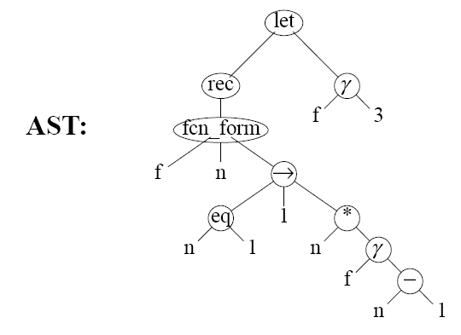

Slide 37
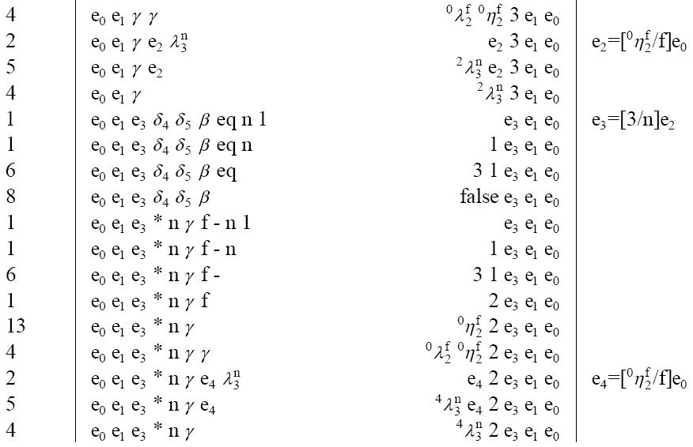

Slide 39
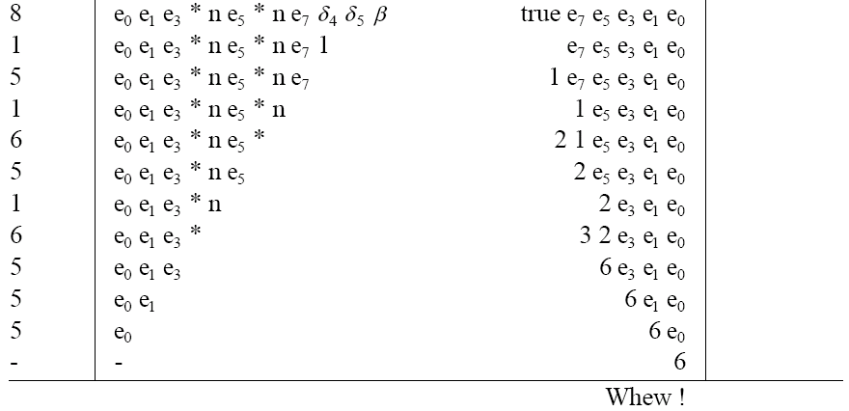

Slide 40
Thank You!

Slide 41
REFERENCES
Programming Language Pragmatics by Michael L. Scott. 3rd edition. Morgan Kaufmann Publishers. (April 2009).
Lecture Slides of Dr.Malaka Walpola and Dr.Bermudez

